Slide 1
A murine model of glucocorticoid myopathy alleviation using androgen therapy
Nicolae Lucian Sandor
July 13th, 2015

Slide 2
Glucocorticoids in humans
Stress hormones working towards hyperglycemia
Abnormal increase in Cushing’s syndrome.
Activate immunosuppressive mechanisms.
Prescribed to ~1% per annum.
Effects include
insulin resistance
osteopenia
muscle loss.
Less specific glucocorticoids cause edema.

Slide 3
Glucocorticoid myopathy
Complaint of 50% of patients.
Objective loss of force, volume.
Electromyography demonstrates it is a myofiber condition.
Can be modelled in vitro.
Increased urinary nitrogen, methylhistidine.
Treatable by cessation, inhibitors, anabolic adjuvants.

Slide 4
Could testosterone help?
Effective in sarcopenia of aging, HIV+.
Causes increase in protein synthesis and decrease in protein degradation.
Hypercortisolism reduces testosterone.
Anecdotal: was standard of care until 1980’s.
Crawford et al. (2003) showed Testo addition to chronic GC causes:
higher bone density
improved muscle mass and strength
better quality of life.
FDA warnings are not helping.

Slide 5
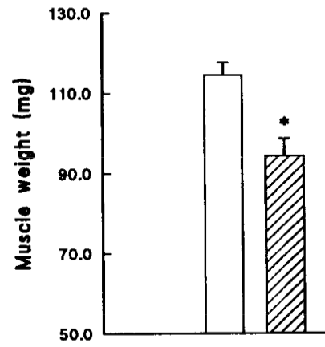
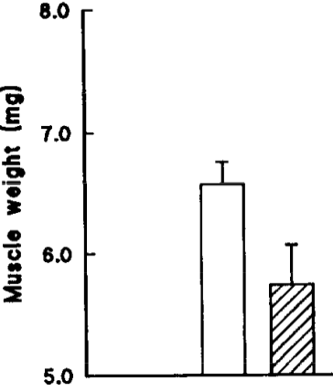
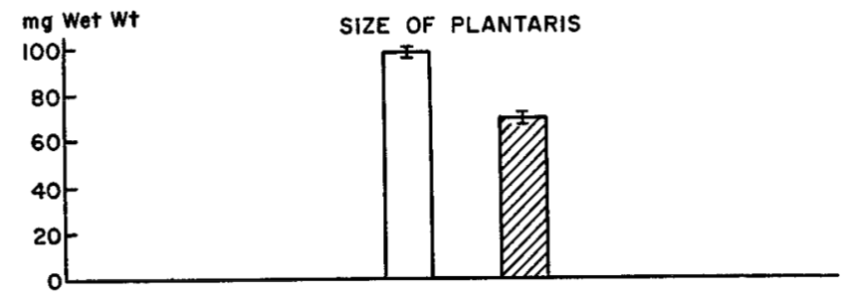
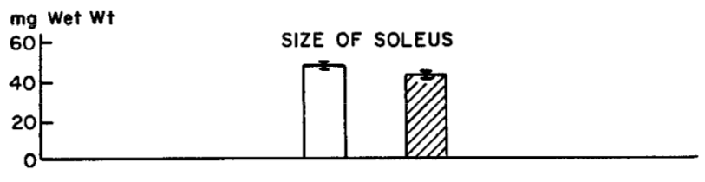
Animal models of glucocorticoid myopathy
Gastrocnemius
Soleus
Hatched bars for seven-day 10 mg/kg cortisone on adult male rats (Goldberg, JBC, 1969).
Pair-feeding does not change findings.
Hatched bars for ten-day 5 mg/kg dexamethasone on male mice (Agbenyega et al., Comp Physiol, 1992).

Slide 6
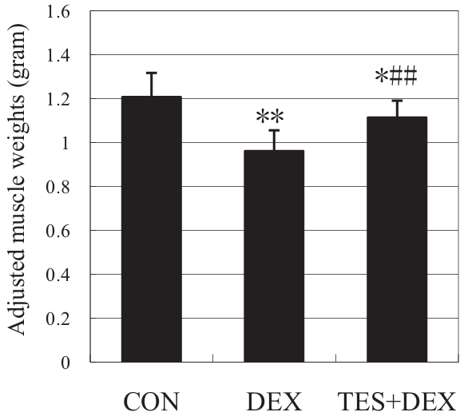
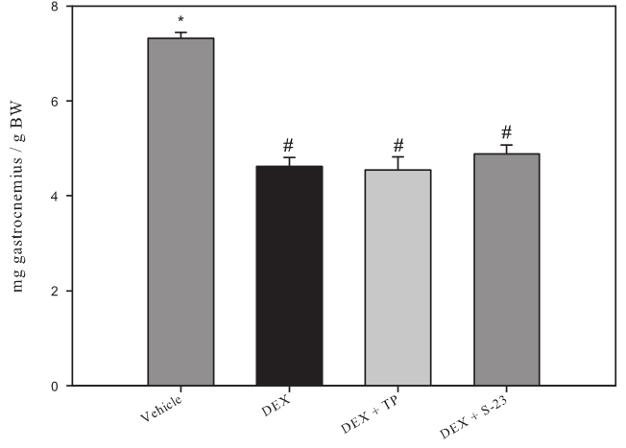
Rats may benefit from testosterone co-administration
Gastrocnemius.
Ten-day 1 mg/kg dexamethasone
± 5 mg/kg testosterone (Yin, J Trauma, 2009).
Gastrocnemius.
Eight-day 0.6 mg/kg dexamethasone
± 25 mg/kg testosterone (Jones, Endocrinology, 2010).

Slide 7
Hypothesis
Testosterone alleviates dexamethasone-induced muscle atrophy in mice.

Slide 8
Mechanisms of Dexa in rats
Increase in urinary 3MH.
Amino acid release decreases by 80% when co-treated with MG132.
Two E3 ligases (“atrogenes”) upregulated.
Other proteolytic mechanisms are involved.

Slide 9
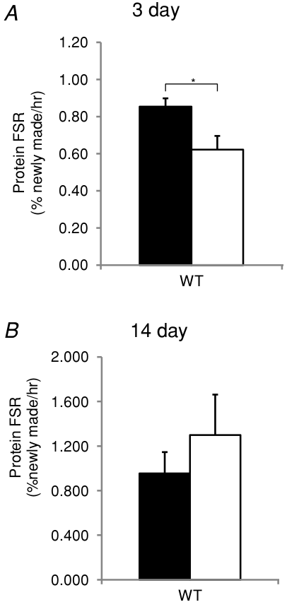
Protein synthesis and Dexa
3 mg/kg dexamethasone on male mice
(Baehr et al., J Physiol, 2012).
More caveats later.

Slide 10
Testosterone effect on atrophying muscle
Often shown to improve protein synthesis.
Recently shown to inhibit protein degradation:
Ferrando et al., 2003, in aging men.
Serra, Sandor, Bhasin, et al., 2013, in castrated mice.

Slide 11
Hypotheses
Testosterone alleviates dexamethasone-induced muscle atrophy in mice.
In dexamethasone-induced muscle atrophy, testosterone’s myoprotective action includes an anti-catabolic component.

Slide 12
Glucocorticoids’ transcriptional effect
Myostatin
Klf15
GR
MuRF1
muscle
loss
Dexa
Foxo
4EBP

Slide 13
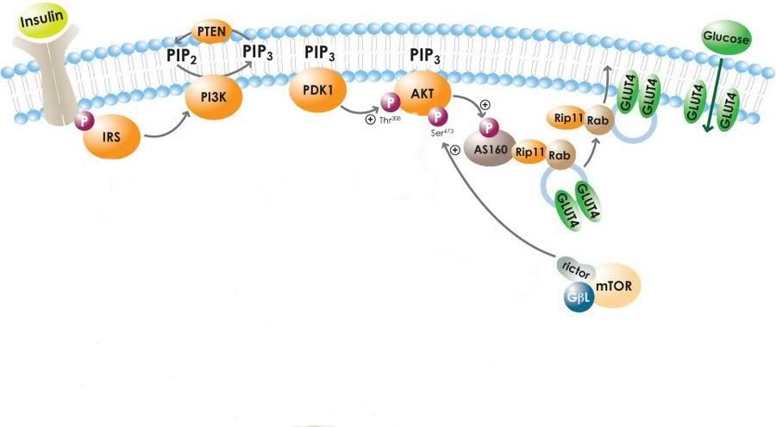
Insulin signaling desensitization
May, 2010
Glucocorticoids increase glucose, insulin, but lower glucose uptake.
Putative points of inhibition include IRS 1 and p85.

Slide 14
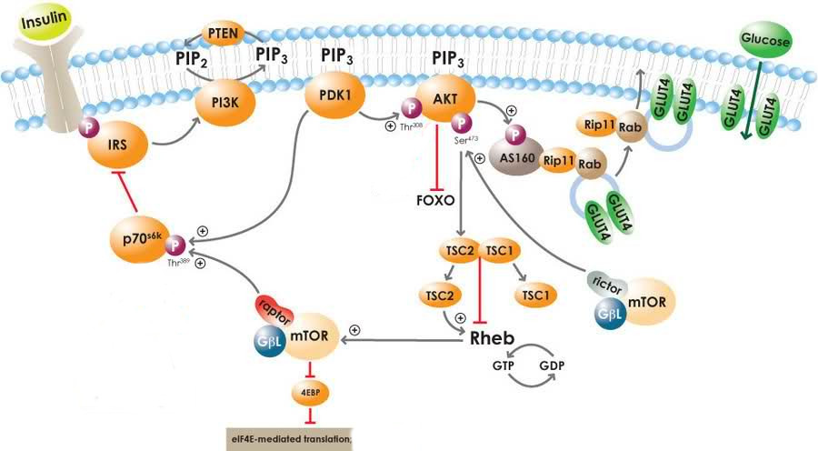
Results of Akt desensitization

Slide 15
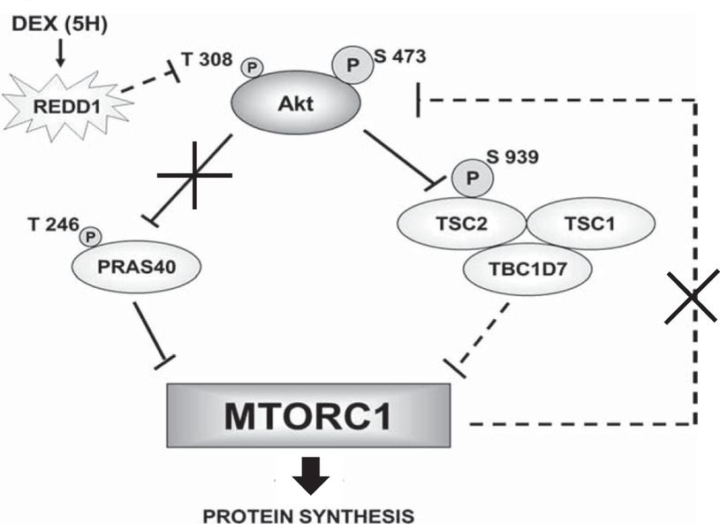
Even more Foxo activation
Britto et al., Am J Physiol, 2014.

Slide 16
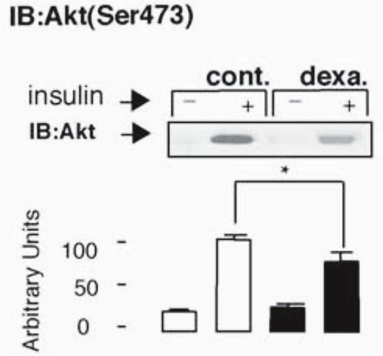
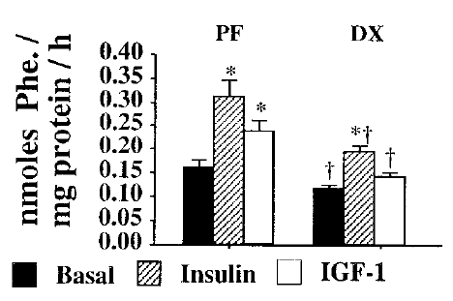
Insulin desensitization
Dardevet et al., J Endocr, 1998.
Rojas et al., Endocrin, 2003.
Also seen with IGF-I.
Dexa effect is easy to miss.

Slide 17
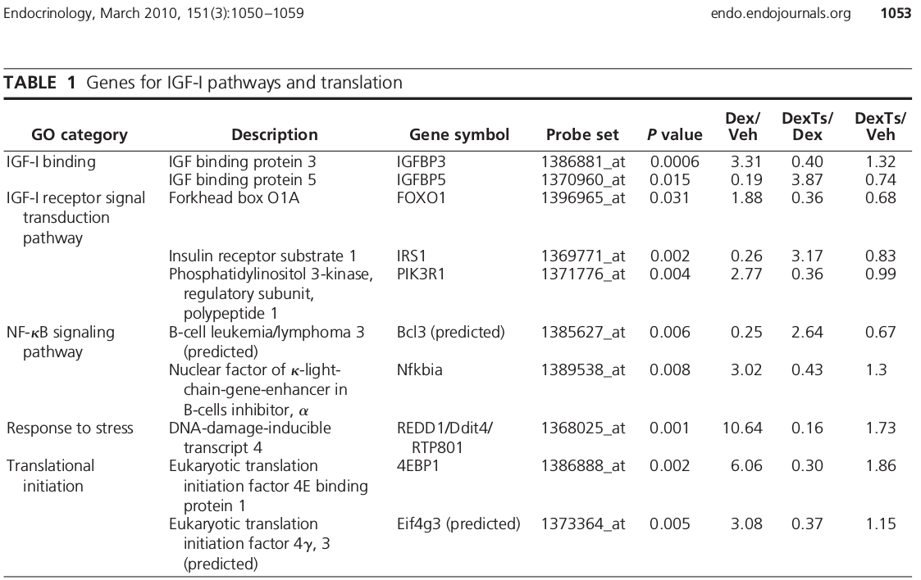
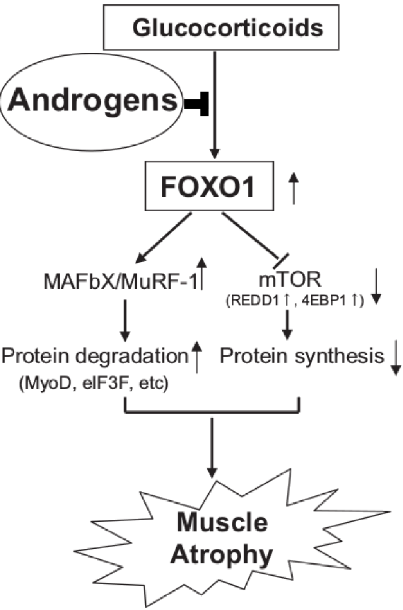
Foxo as mediators of testosterone muscle protection
Qin et al., BBRC, 2010.
Wu et al., Endocrinology, 2010.

Slide 18
Third hypothesis
Testosterone alleviates dexamethasone-induced muscle atrophy in mice.
In dexamethasone-induced muscle atrophy, testosterone’s myoprotective action includes an anti-catabolic component.
Testosterone’s myoprotective action relies on inhibition of Foxo facilitated by restoration of IGF-I.

Slide 19
Findings
Mouse model
Macroscopic changes
Metabolic changes
Molecular mediators
Cell model
Histological changes
Metabolic changes
Molecular effectors

Slide 20

In vivo test
± 10 mg / kg D, ± 28 mg / kg T
Tissue collection
V
D
Time (days)
D+T
Eight week old, male, C57BL/6.

Slide 21
Progressive loss of body weight is alleviated by testosterone
body weight
(% gain)

Slide 22
Deeper in vivo probe
V
Tissue collection
D
Time (days)
D+T
V
Tissue collection
D
Time (days)
D+T
V
Tissue collection
D
Time (days)
D+T

Slide 23
Net effects on body weight become evident when treated for longer
body weight
(% gain)

Slide 24
Testosterone partly restores lean mass
fat mass
gain (g)
lean mass
loss (g)
Only dexamethasone alters fat deposits.
Testosterone effects are more salient in longer-treated group.

Slide 25
Testosterone partly restores individual muscles
gastrocnemius (g)
triceps br. (g)
quadriceps (g)
levator ani (g)
one day
three days
seven days
one day
three days
seven days

Slide 26
Conclusion so far
Testosterone reduces dexamethasone-induced reduction in mouse muscle mass.

Slide 27
MuRF1 is restored to baseline levels by testosterone co-administration
gastrocnemius MuRF1 mRNA
quadriceps MuRF1 mRNA
gastrocnemius MAFbx mRNA
quadriceps MAFbx mRNA
one day
three days
seven days

Slide 28
Chymotrypsin-like activity correlates with phenotype
quadriceps proteasome catalytic activity (rel.u.)
No ladder pattern of ubiquitinated myosin.
triceps proteasome catalytic activity (rel.u.)
three days

Slide 29
Dexamethasone represses autophagosome-associated genes
gastrocnemius beclin mRNA
gastrocnemius cathepsin L mRNA
gastrocnemius LC3 mRNA
one day
three days
seven days

Slide 30
Cathepsin L activity does not correlate with phenotype
gastrocnemius autophagosome catalytic activity (rel.u.)
quadriceps autophagosome catalytic activity (rel.u.)
triceps autophagosome catalytic activity (rel.u.)
one day
three days
seven days

Slide 31
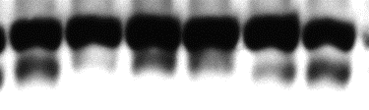

Lipidated LC3 isoform indicates autophagy unchanged
slow >
LC3
fast >
GAPDH
Dexa | - | - | + | + | + | +
Testo | - | - | - | - | + | +
LC3-II normalized to GAPDH
LC3-II normalized to LC3-I
Gastrocnemius, 7 day.
Sub-optimal normalization has been used by others to hypothesize role of autophagy.

Slide 32
Calpain markers did not correlate with the phenotype
gastrocnemius calpain catalytic activity (rel.u.)
one day
three days
seven days
Also, no change in mu-calpain, calpastatin protein levels.

Slide 33
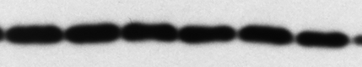


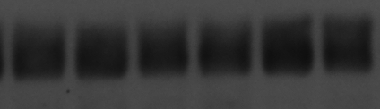
Translation regulators appear unchanged
Ⓟ-eIF2α
eIF3f
GAPDH
GAPDH
Dexa | — | — | + | + | + | +
Testo | — | — | — | — | + | +
Dexa | — | — | + | + | + | +
Testo | — | — | — | — | + | +
Ⓟ-eIF2α
eIF3-f
gastrocnemius, day 7

Slide 34
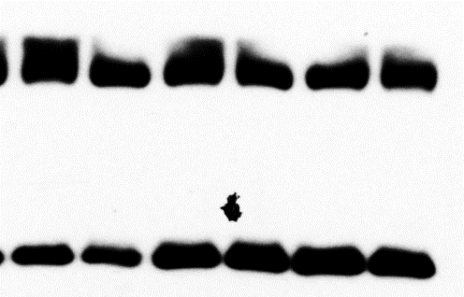
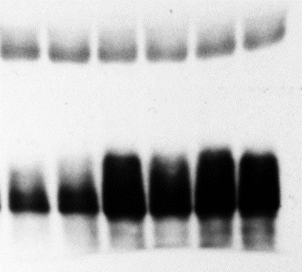
4E-BP is not inhibited by testosterone
GAPDH
GAPDH
Ⓟ-4EBP
total 4EBP
Dexa | — | — | + | + | + | +
Testo | — | — | — | — | + | +
Dexa | — | — | + | + | + | +
Testo | — | — | — | — | + | +
total 4EBP
Ⓟ-4EBP
gastrocnemius, day 7
Could not employ polysome profiling.

Slide 35
Conclusions so far
Dexamethasone-induced loss of muscle is correlated with an increase in proteasome activity and E3 ligases expression.
Rescue by testosterone co-administration is correlated with proteasome repression.
Significant autophagy changes contrast with the phenotype.
Calpains, protein synthesis changes are less correlated with the phenotype.

Slide 36
Testosterone pushes the transcriptional lever
quadriceps Foxo3a mRNA
quadriceps Klf15 mRNA
one day
three days
seven days

Slide 37
IGF-I is partly restored by testosterone co-administration
quadriceps
IGF-I Ea mRNA
one day
three days
seven days

Slide 38
Testosterone partly reverses REDD1 upregulation
gastrocnemius
REDD1 mRNA
quadriceps
REDD1 mRNA
one day
three days
seven days

Slide 39
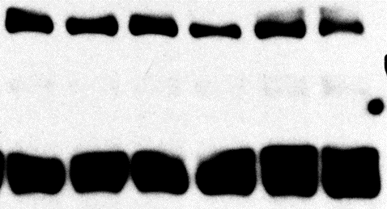
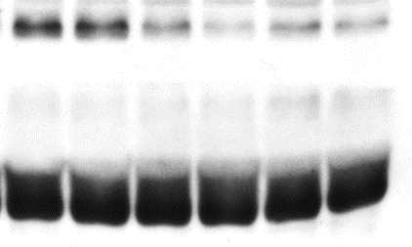
Akt (Ser 473) does not respond to testosterone
total Akt
Ⓟ473-Akt
GAPDH
GAPDH
Dexa | — | — | + | + | + | +
Testo | — | — | — | — | + | +
Dexa | — | — | + | + | + | +
Testo | — | — | — | — | + | +
total Akt
Ⓟ473-Akt
Ⓟ473-Akt /
total Akt
Gastrocnemius, 7 day.

Slide 40
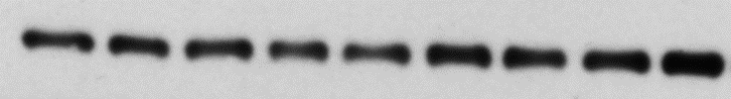
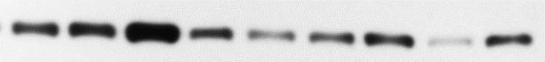
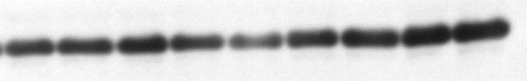
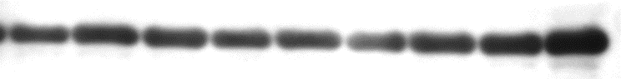
Akt (Ser 473) does not respond to testosterone in hypersensitive levator
total Akt
Ⓟ473-Akt
GAPDH
GAPDH
Dexa | — | — | — | + | + | + | + | + | +
Testo | — | — | — | — | — | — | + | + | +
Dexa | — | — | — | + | + | + | + | + | +
Testo | — | — | — | — | — | — | + | + | +
total Akt
Ⓟ473-Akt
Ⓟ473-Akt /
total Akt

Slide 41
Conclusions so far
Testosterone’s protective action is associated with restoration of Foxo signals.
Transcriptional mediators Klf15 and Foxo are altered by testosterone.
REDD1 and IGF-I are partly restored by testosterone.
Basal state repression of Akt by dexamethasone appears unchanged by testosterone co-administration.

Slide 42
Hypotheses
Testosterone alleviates dexamethasone-induced muscle atrophy in mice.
In dexamethasone-induced muscle atrophy, testosterone’s myoprotective action includes an anti-catabolic component.
Testosterone’s myoprotective action relies on inhibition of Foxo facilitated by restoration of IGF-I.
√
√
…

Slide 43
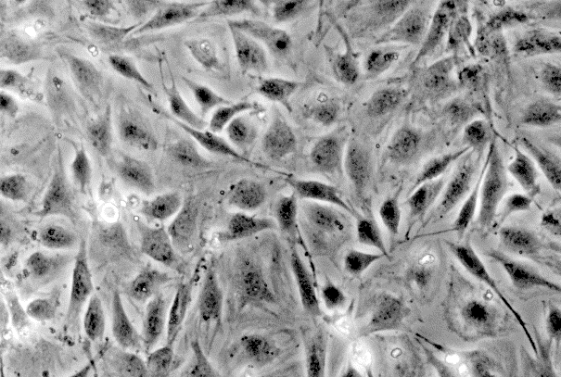
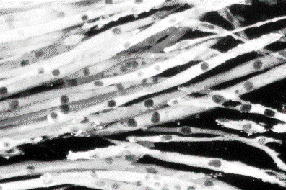
Dexa is anabolic, pro-proliferative for the undifferentiated muscle cells
Start differentiation
Serum-free medium
Time
(days)
Undifferentiated
Differentiated
Many studies discuss effect of the glucocorticoids or combination on proliferating or differentiating cells.

Slide 44
Previous in vitro models
Rat cell studies brought us:
dexamethasone-induced proteolysis
constitutively active and dominant negative Foxo in IGF-I context
LC3 accumulation.
Mouse cell studies are scarce.

Slide 45



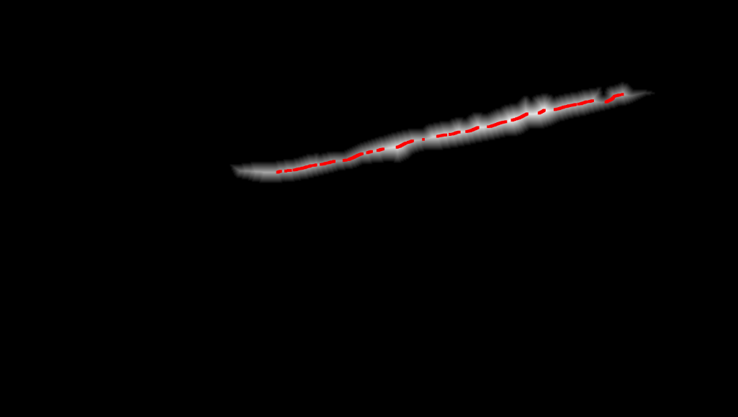
Novel computer-assisted analysis
(B) Matlab
(A) Photoshop

Slide 46
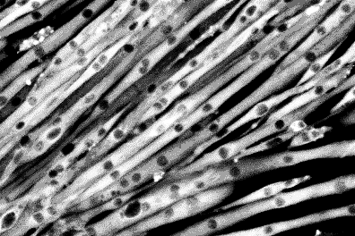
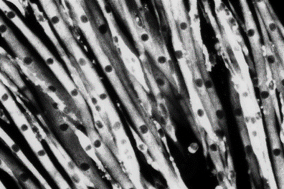
Cell diameter is rescued by testosterone co-administration
Start differentiation
Start pharmacological treatments
Diff. M.
±T±D
Time
(days)
Vehicle
Differentiated
average cell diameter (rel. u.)
50 µM Dexa
Dexa +
300 nM Testo

Slide 47
Total protein content is restored by testosterone co-administration
Start differentiation
Start pharmacological treatments
1 d
Diff. M.
±T±D
Time
(days)
2 d
Diff. M.
±T±D
total protein (normalized to first day)
At 48 hour, statistically significant difference between Dexa and Veh.
At 48 hour, statistically significant difference between Dexa and Dexa + Testo.

Slide 48
Assaying protein synthesis in vitro
Start differentiation
Start pharmacological treatments
Diff. M.
0 d
±T±D
Time
(days)
³H-Phe
Diff. M.
1 d
±T±D
³H-Phe
Diff. M.
2 d
±T±D
³H-Phe
Diff. M.
3 d
±T±D
³H-Phe
Preliminary studies showed lack of sensitivity for 4h and 30h.

Slide 49
Protein synthesis exhibits paradoxical, late increase
tracer enrichment
in cell protein
(fmol/g)
At 72 hour, statistically significant difference between Dexa and Veh.
At 72 hour, statistically significant difference between Dexa and Dexa + Testo.
No change in pattern if normalization is foregone.

Slide 50
Assaying protein degradation in vitro
Start differentiation
Start pharmacological treatments
Diff. M.
Time
(days)
0 d
±T±D
³H-Phe
Diff. M.
1 d
±T±D
³H-Phe
Diff. M.
2 d
±T±D
³H-Phe
Diff. M.
3 d
±T±D
³H-Phe
Preliminary studies showed very low tracer uptake past 48 hour.

Slide 51
Protein degradation correlates with phenotype
medium to cell protein tracer ratio
At 24 hour, statistically significant difference between Dexa and Veh.
At 24 hour, statistically significant difference between Dexa and Dexa + 500 nM Testo.

Slide 52
Inhibitor tests in vitro
Protein
labeling
Start steroid
treatments
Start
differentiation
Diff. M.
Time (days)
±T±D
³H-Phe
Collection of measured medium

Slide 53
Proteasome is responsible for bulk digestion
medium to cell protein tracer ratio
Strongest inhibition of proteolysis with proteasome inhibitor MG132.
Non-negligible effect of lysosome inhibitor chloroquine.
Repression to basal level with T co-administration.
IGF1R inhibitor did not alter T effect.

Slide 54
Limitations
Role of Foxo, Akt, REDD1 was studied in observational manner.
It may be impossible to observe dexamethasone-induced changes in insulin / IGF-I signaling without insulin stimulation.
There is no direct method of measurement for autophagy.

Slide 55
General model
Glucocorticoids
Anabolic steroids
REDD1
IGF-I
Akt
Foxo
MuRF1
proteasome / ubiquitin - mediated catabolism

Slide 56
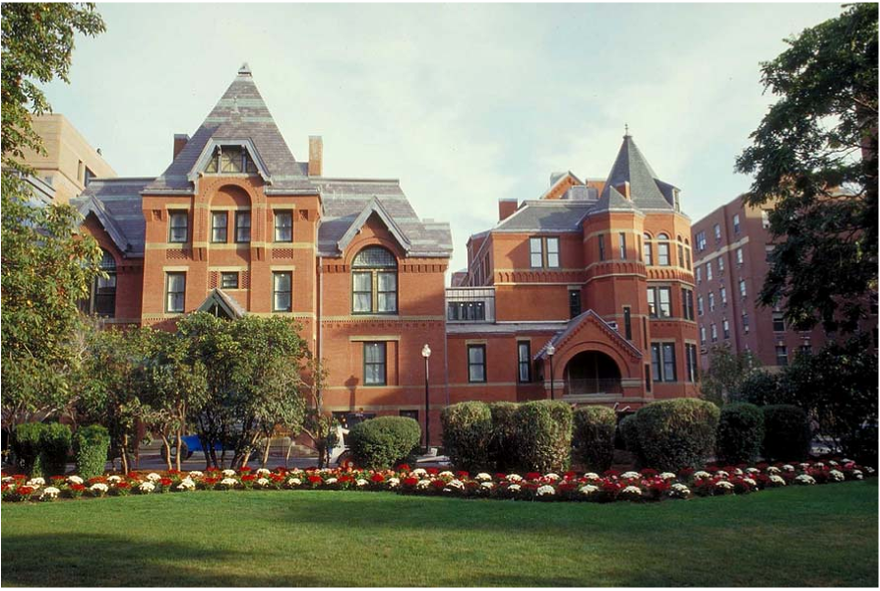
Acknowledgements

